Slide 1

CSS Layout
Control the arrangement of the HTML elements

Slide 2
Table of Contents
Width and Height
Overflow
Visibility
Display

Slide 3
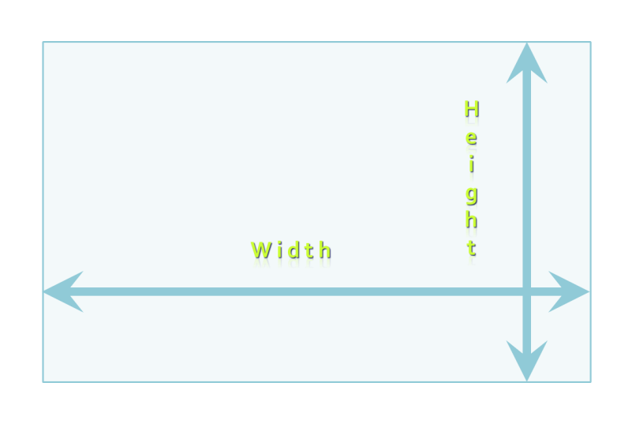

W i d t h
H e i g
h t
H e i g
h t
W i d t h

Slide 4
Width
width – defines numerical value for the width of element, e.g. 200px
width applies only for block elements
Their with is 100% by default
The width of inline elements is always the width of their content, by concept
min-width - defines the minimal width
min-width overrides width if (width<min-width)
max-width - defines the maximal width
max-width overrides width if (width>max-width)

Slide 5
Width Values
The values of the width property are numerical:
Pixels ( px)
Centimeters (cm)
Or percentages
A percent of the available width

Slide 6
Width
Live Demo

Slide 7
Height
height – defines numerical value for the height of element, e.g. 100px
height applies only on block elements
The height of inline elements is always the height of their content
min-height - defines the minimal height
min-height overrides height
max-height - defines the maximal height
max-height overrides height

Slide 8
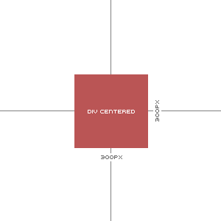
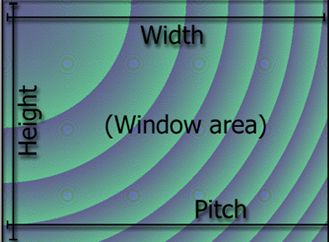
Height
Live Demo

Slide 9



Overflow

Slide 10
Overflow
overflow: defines the behavior of element when content needs more space than the available
overflow values:
visible (default) – content spills out of the element
auto - show scrollbars if needed
scroll – always show scrollbars
hidden – any content that cannot fit is clipped

Slide 11


Overflow
Live Demo

Slide 12
Display

Slide 13
Display
display: controls the display of the element and the way it is rendered and if breaks should be placed before and after the element
inline: no breaks are placed before and after (<span> is an inline element)
The element's height and width depend on the size of the content
block: breaks are placed before AND after the element (<div> is a block element)
Height and width may not depend on the size of the content

Slide 14
Display (2)
display: controls the display of the element and the way it is rendered and if breaks should be placed before and after the element
none: element is hidden and its dimensions are not used to calculate the surrounding elements rendering (differs from visibility: hidden!)
inline-block: : no breaks are placed before and after (like inline)
Height and width can be applied (like block)

Slide 15
Display (3)
display: controls the display of the element and the way it is rendered and if breaks should be placed before and after the element
table, table-row, table-cell : the elements are arranged in a table-like layout

Slide 16

Display
Live Demo

Slide 17
Visibility

Slide 18
Visibility
visibility
Determines whether the element is visible
hidden: element is not rendered, but still occupies place on the page (similar to opacity:0)
visible: element is rendered normally

Slide 19
Visibility
Live Demo

Slide 20
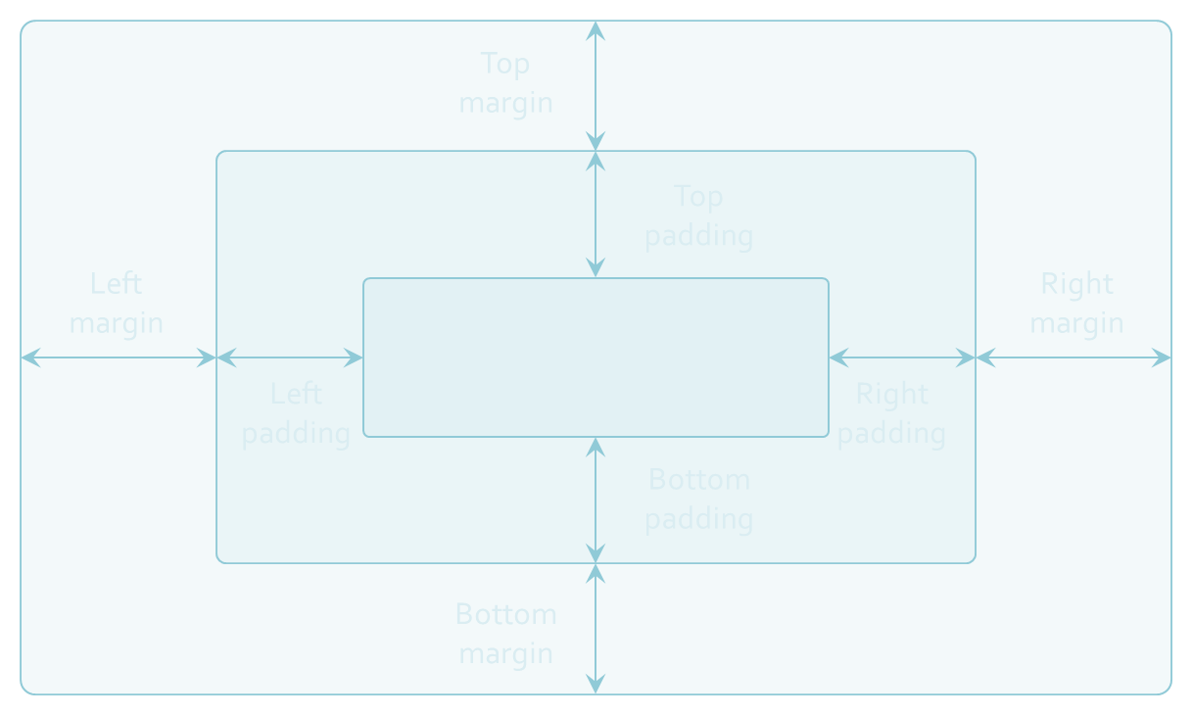
Margins and Paddings

Slide 21
Margin and Padding
margin and padding define the spacing around the element
Numerical value, e.g. 10px or -5px
Can be defined for each of the four sides separately - margin-top, padding-left, …
margin is the spacing outside of the border
padding is the spacing between the border and the content
What are collapsing margins?

Slide 22
Margin and Padding: Short Rules
margin: 5px;
Sets all four sides to have margin of 5 px;
margin: 10px 20px;
top and bottom to 10px, left and right to 20px;
margin: 5px 3px 8px;
top 5px, left/right 3px, bottom 8px
margin: 1px 3px 5px 7px;
top, right, bottom, left (clockwise from top)
Same for padding

Slide 23

Margins and Paddings
Live Demo

Slide 24
The Box Model
Margin
Border
Padding
Content

Slide 25
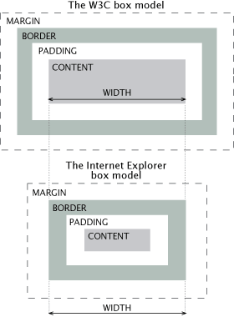
IE Quirks Mode
When using quirks mode (pages with no DOCTYPE or with a HTML 4 Transitional DOCTYPE)
Internet Explorer violates the box model standard!

Slide 26
IE Quirks Mode
Live Demo

Slide 27
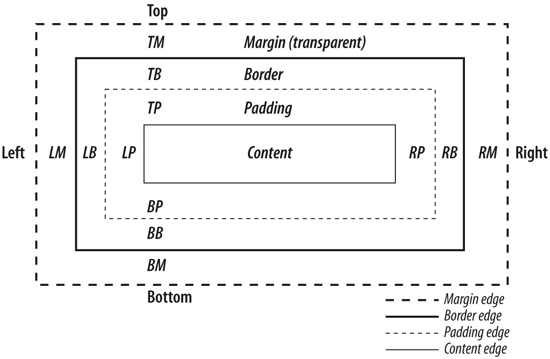
Box Model

Slide 28
CSS3 box-sizing
Determine whether you want an element to render it's borders and padding within its specified width, or outside of it.
Possible values:
box-sizing: content-box (default) box width: 288 pixels + 10 pixels padding and 1 pixel border on each side = 300 pixels
box-sizing: border-box box width: 300 pixels, including padding and borders

Slide 29
CSS3 box-sizing (Example)
Example: Box with total width of 300 px (including paddings and borders)
width: 300px;
border: 1px solid black;
padding: 5px;
/* Firefox */
-moz-box-sizing: border-box;
/* WebKit */
-webkit-box-sizing: border-box;
/* Opera 9.5+, Google Chrome */
box-sizing: border-box;

Slide 30
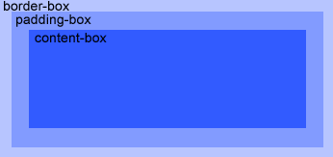
Box Model
Live Demo

Slide 31
Positioning

Slide 32
Positioning
position: defines the positioning of the element in the page content flow
The value is one of:
static (default)
relative – relative position according to where the element would appear with static position
absolute – position according to the innermost positioned parent element
fixed – same as absolute, but ignores page scrolling

Slide 33
Positioning (2)
Margin VS relative positioning
Fixed and absolutely positioned elements do not influence the page normal flow and usually stay on top of other elements
Their position and size is ignored when calculating the size of parent element or position of surrounding elements
Overlaid according to their z-index
Inline fixed or absolutely positioned elements can apply height like block-level elements

Slide 34
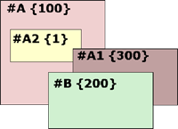
Positioning (3)
top, left, bottom, right: specifies offset of absolute/fixed/relative positioned element as numerical values
z-index : specifies the stack level of positioned elements
Understanding stacking context
Each positioned element creates a stacking context.
Elements in different stacking contexts are overlapped according to the stacking order of their containers. For example, there is no way for #A1 and #A2 (children of #A) to be placed over #B without increasing the z-index of #A.

Slide 35


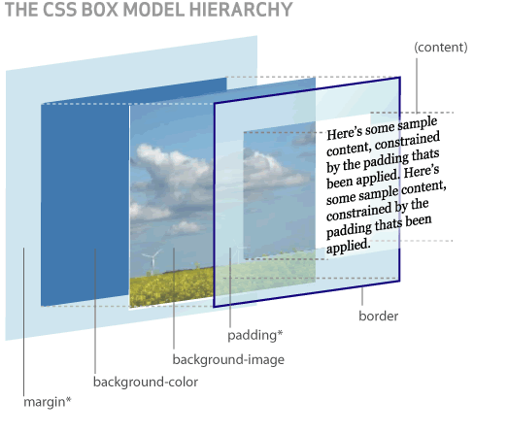
Positioning
Live Demo

Slide 36
Inline element positioning
vertical-align: sets the vertical-alignment of an inline element, according to the line height
Values: baseline, sub, super, top, text-top, middle, bottom, text-bottom or numeric
Also used for content of table cells (which apply middle alignment by default)

Slide 37
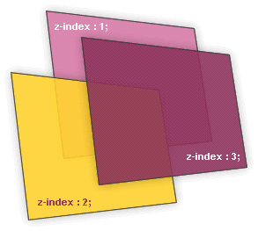

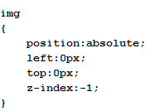
Alignment and Z-Index
Live Demo

Slide 38
Floating

Slide 39
Float
float: the element “floats” to one side
left: places the element on the left and following content on the right
right: places the element on the right and following content on the left
floated elements should come before the content that will wrap around them in the code
margins of floated elements do not collapse
floated inline elements can apply height

Slide 40
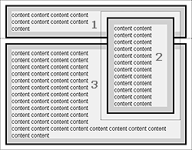
Float (2)
How floated elements are positioned

Slide 41
Clear
clear
Sets the sides of the element where other floating elements are NOT allowed
Used to "drop" elements below floated ones or expand a container, which contains only floated children
Possible values: left, right, both
Clearing floats
Clear using pseudo-class :after
Additional element (<div>) with a clear style
Deprecated - semantically unused div

Slide 42
Clear (2)
Clearing floats (continued)
:after { content: ""; display: block; clear: both; height: 0; }
Triggering hasLayout in IE expands a container of floated elements
zoom: 1
.clearfix {
zoom:1;}
.clearfix: after {
content: "";
display: block;
clear: both;
height: 0; }

Slide 43


Floating Elements
Live Demo

Slide 44
CSS Layout
http://academy.telerik.com

Slide 45
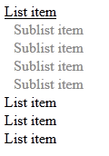
Homework
Create tree view like the following:
When the mouse goes over an item the sub list should be shown
The tree view should work with unlimited number of sub lists

Slide 46

Homework (2)
Create the following Web page using external CSS styles. Buttons should consist of PNG images with text over them.

Slide 47
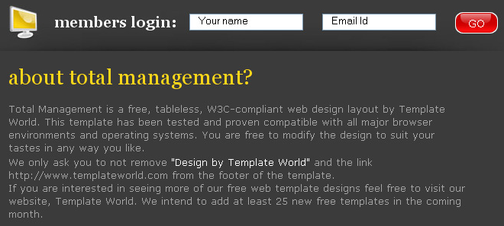
Homework (3)
Create the following Web page using HTML with external CSS file. Note that the images should be PNG with transparent background.

Slide 48
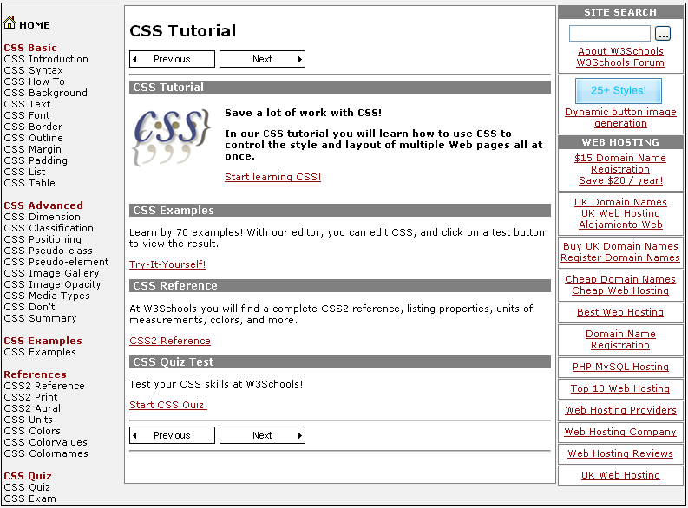
Homework (4)
Given the picture below create the Web site
Use CSS and HTML 5

Slide 49

Homework (5)
Create the following HTML 5 Page
Do it without tables

Slide 50
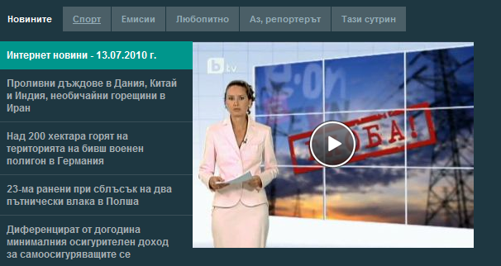
Homework
Create the following Web page using HTML and external CSS. Using tables, inline styles and deprecated tags is not allowed.

